Slide 1
10_Feeders_No_Foreign_WTIVs
t
e
x
t

Slide 2
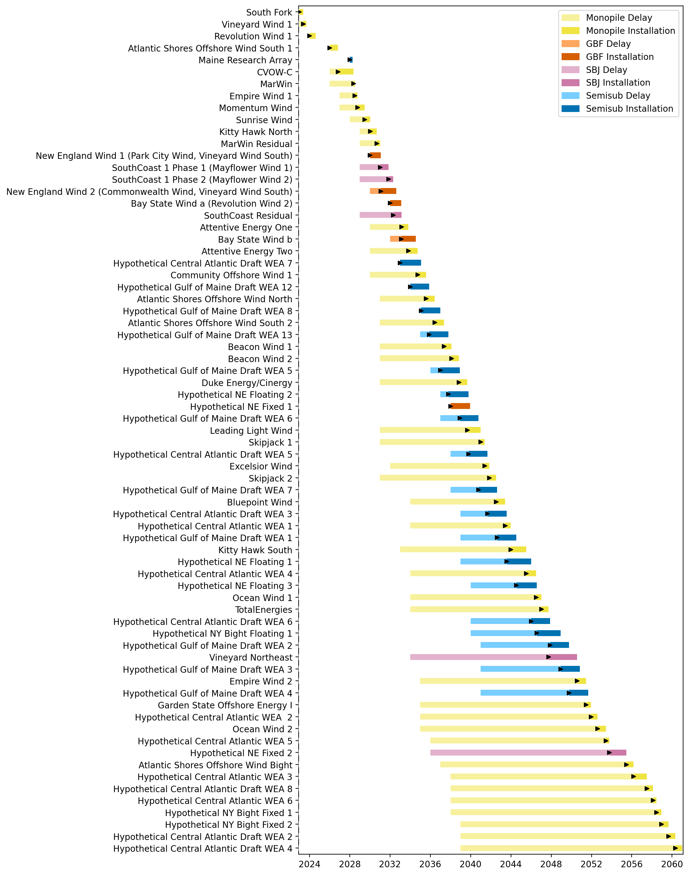
Full Gantt

Slide 3
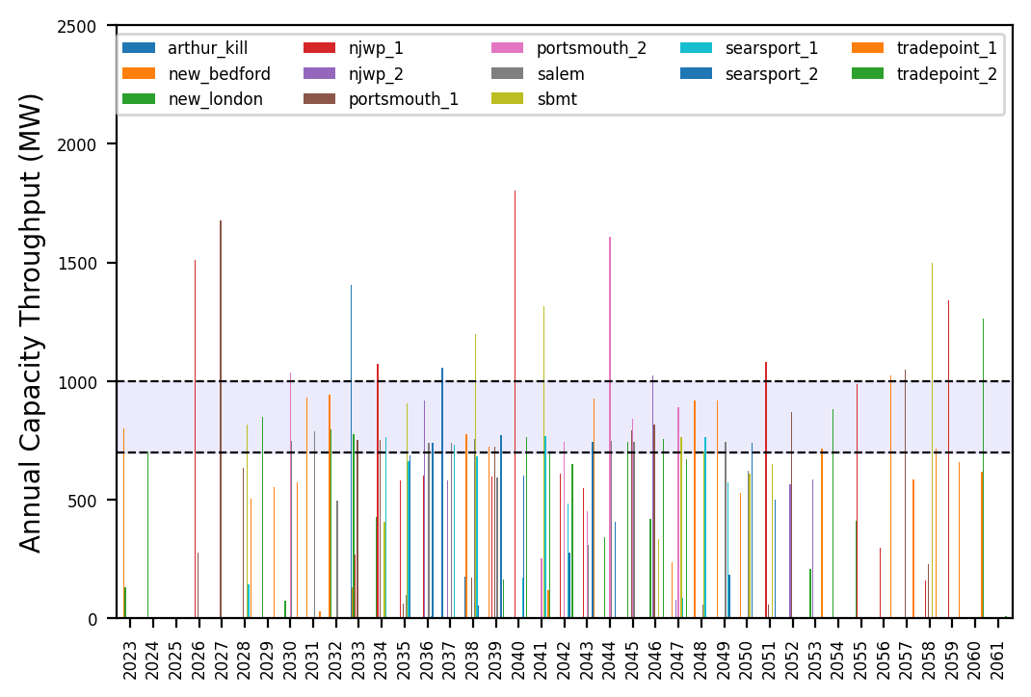
Port Throughput

Slide 4
10_Feeders
t
e
x
t

Slide 5
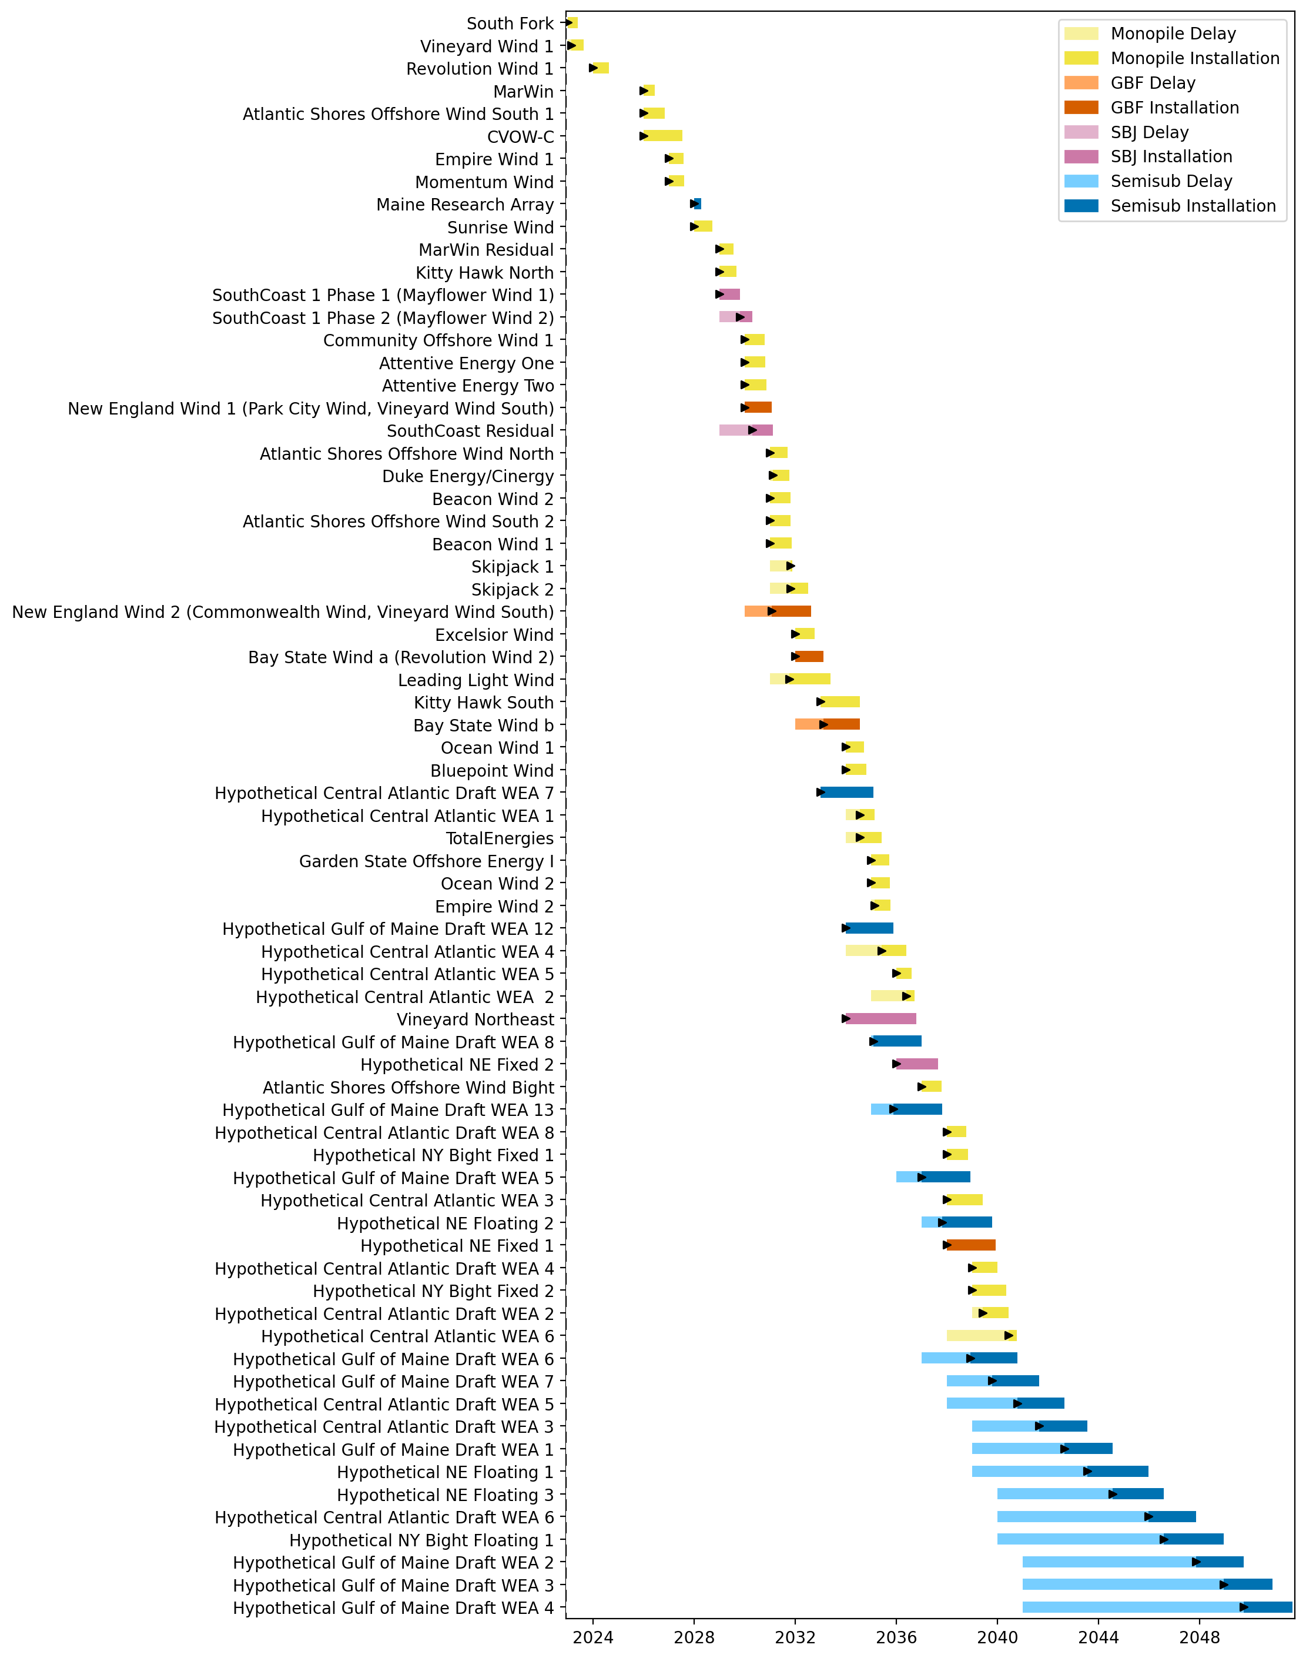
Full Gantt

Slide 6
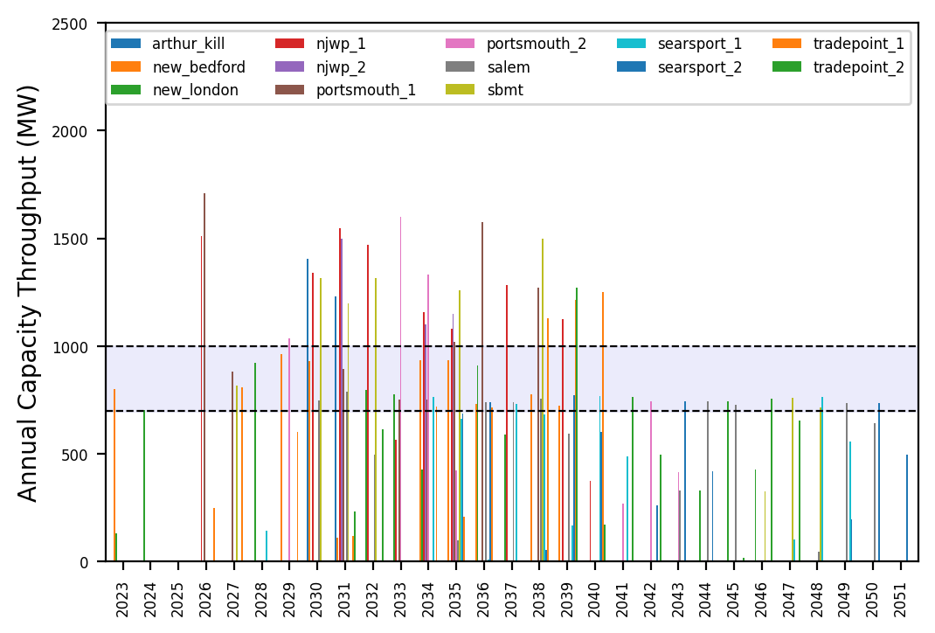
Port Throughput

Slide 7
Hybrid_Diff_Pipeline
t
e
x
t

Slide 8
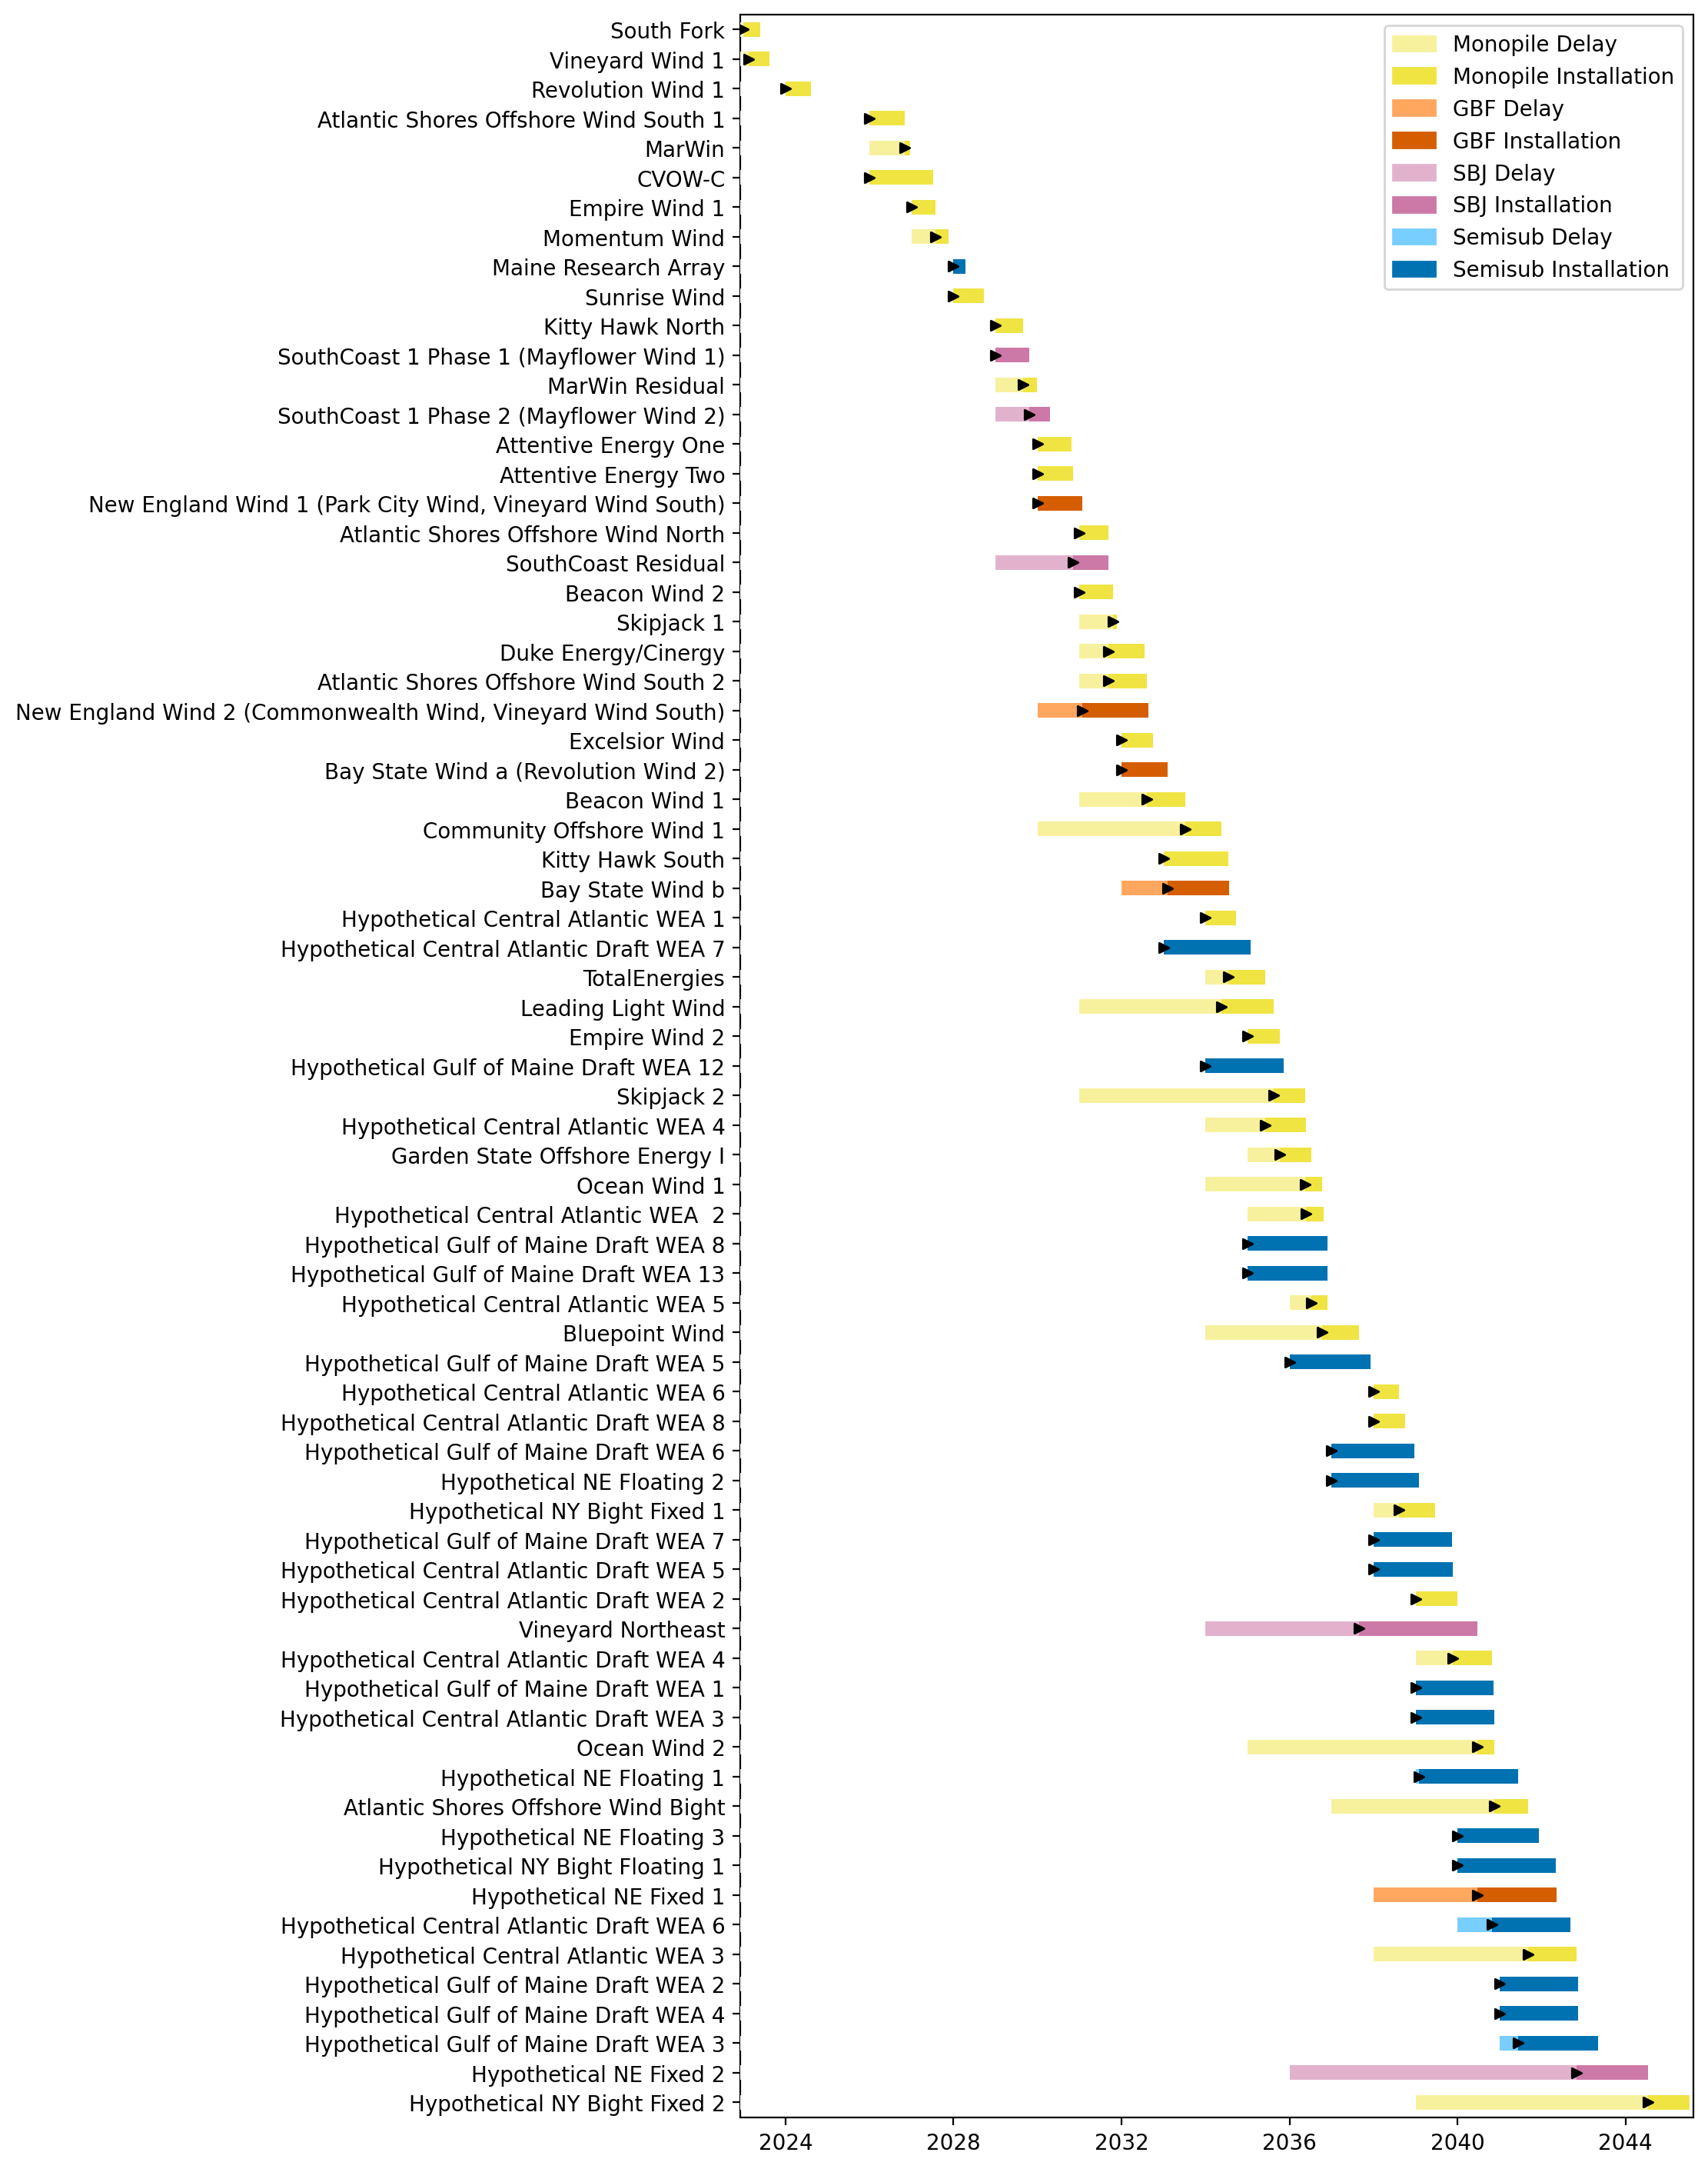
Full Gantt

Slide 9
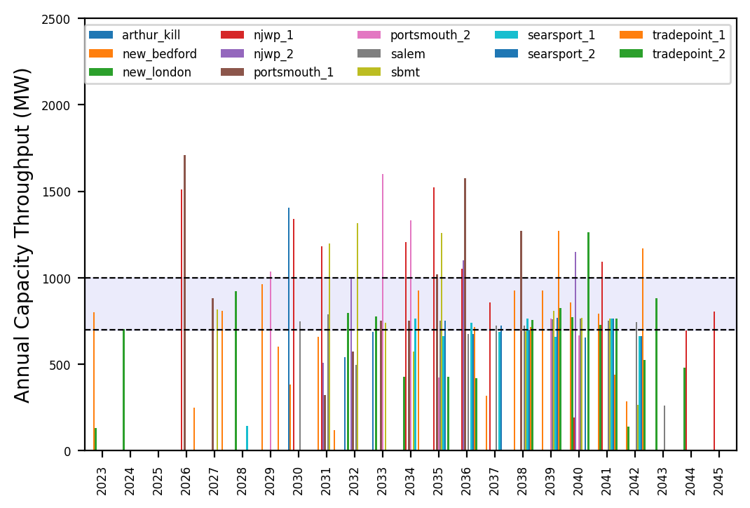
Port Throughput

Slide 10
3_WTIV
t
e
x
t

Slide 11
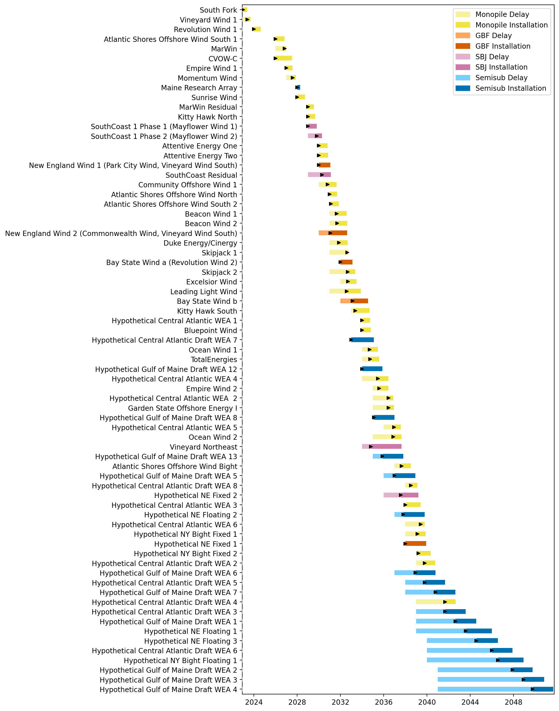
Full Gantt

Slide 12
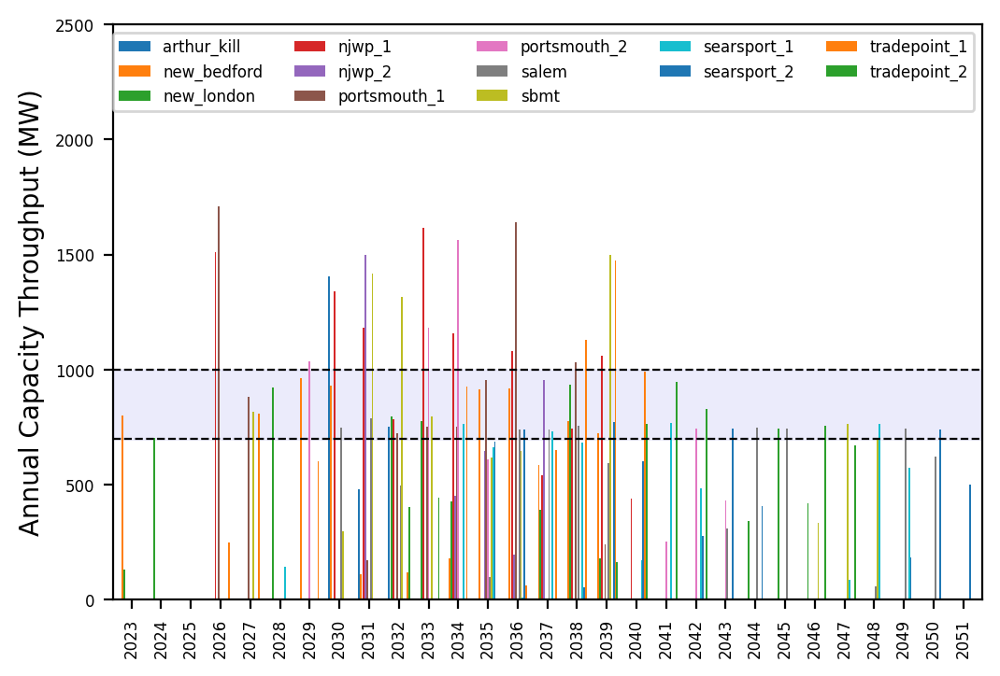
Port Throughput

Slide 13
6_AHTS
t
e
x
t

Slide 14
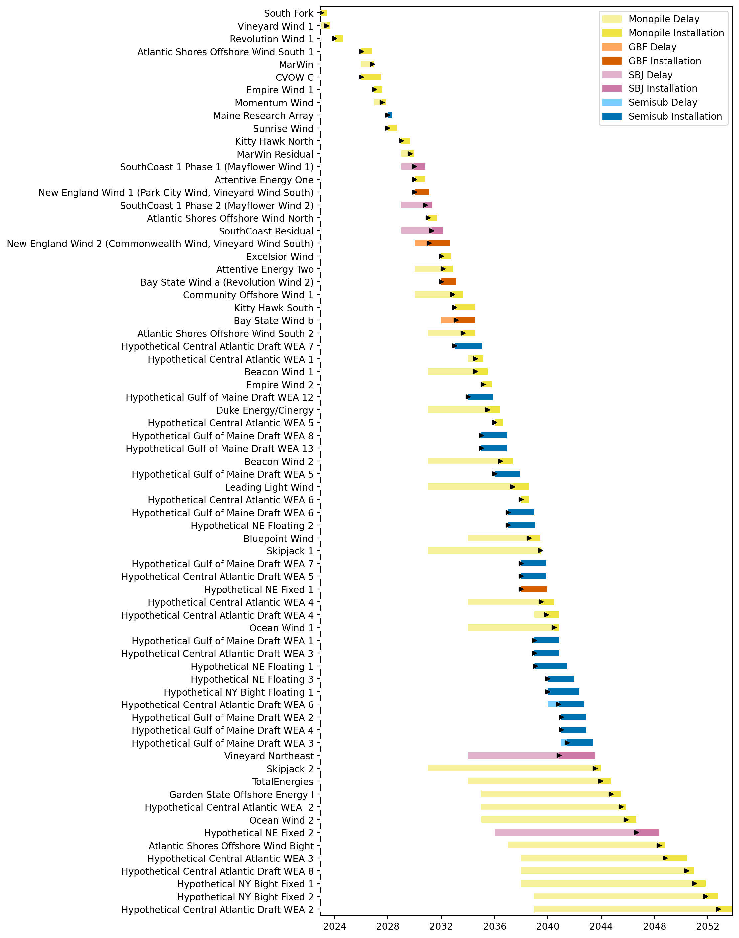
Full Gantt

Slide 15
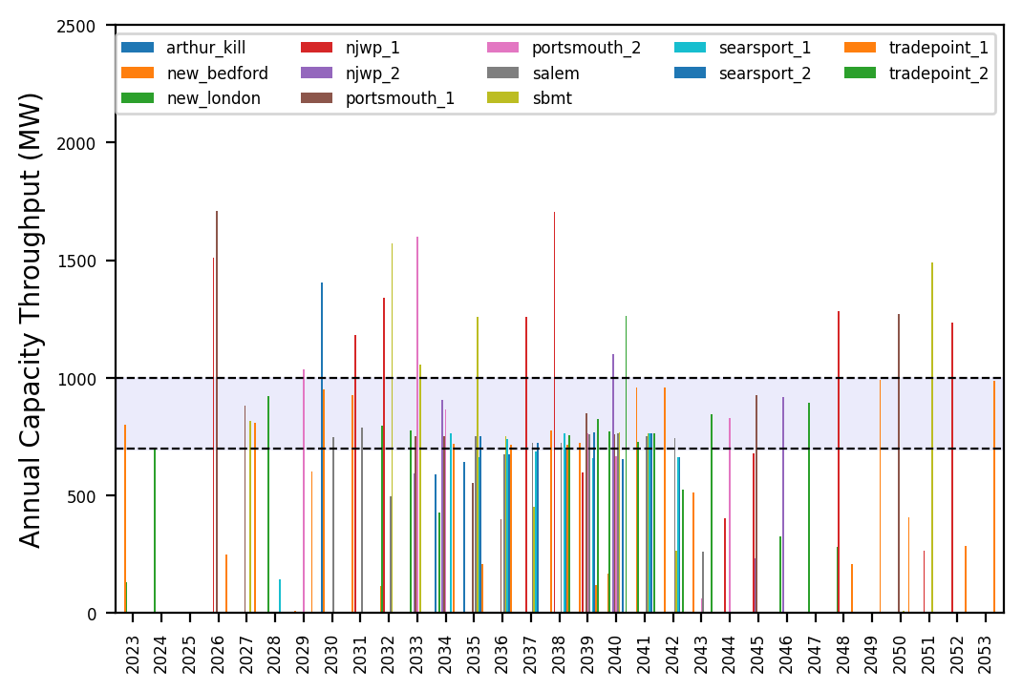
Port Throughput

Slide 16
no_action
t
e
x
t

Slide 17
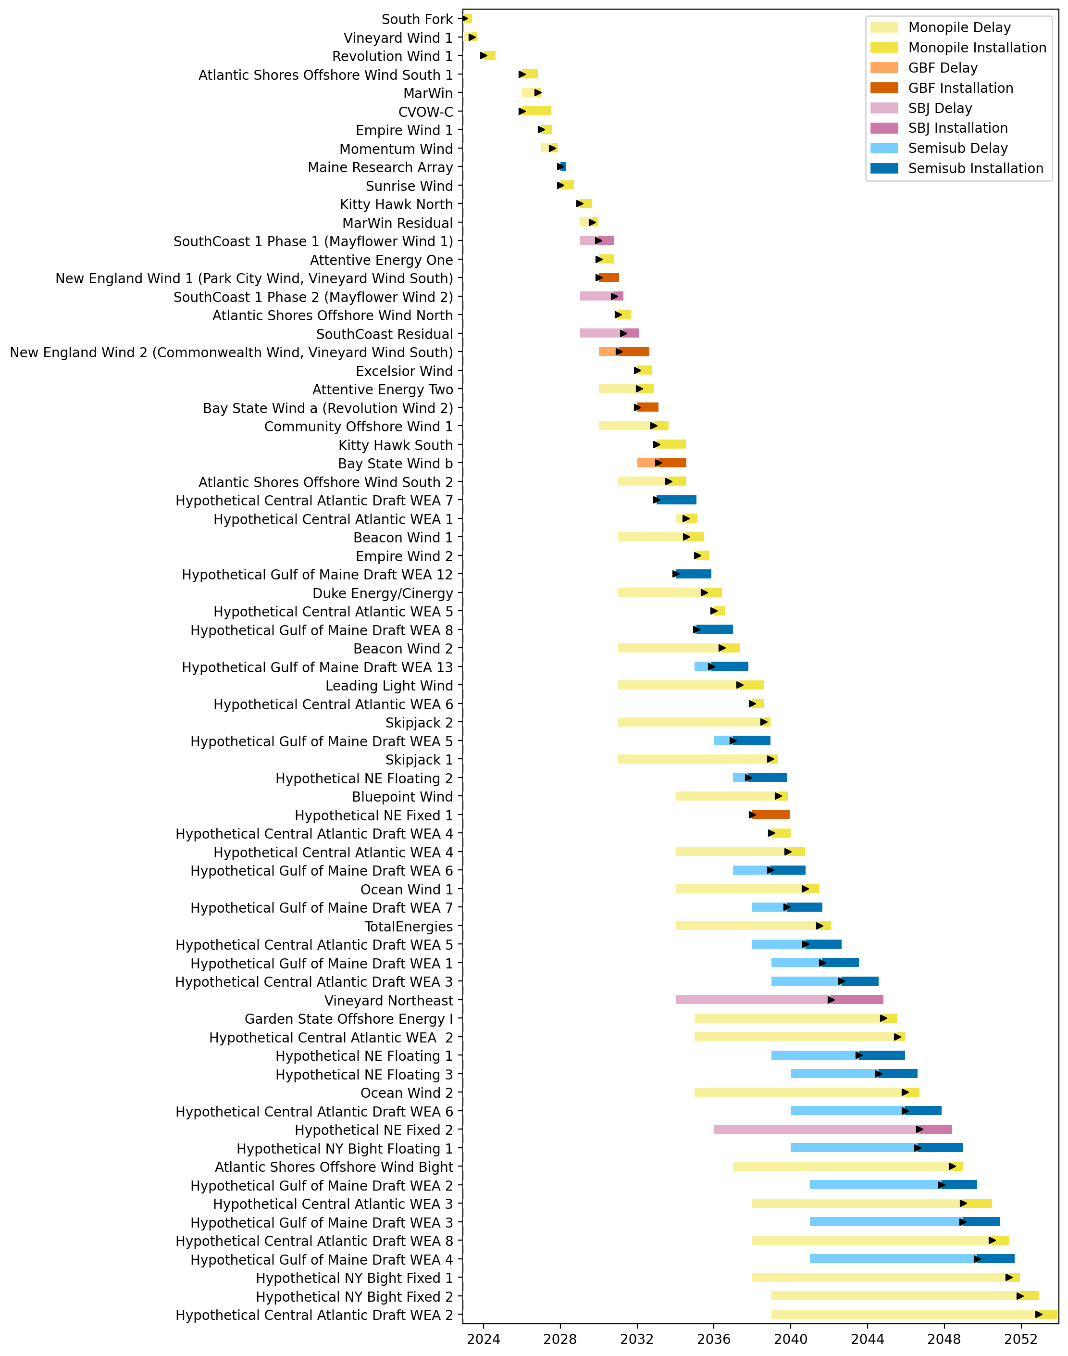
Full Gantt

Slide 18
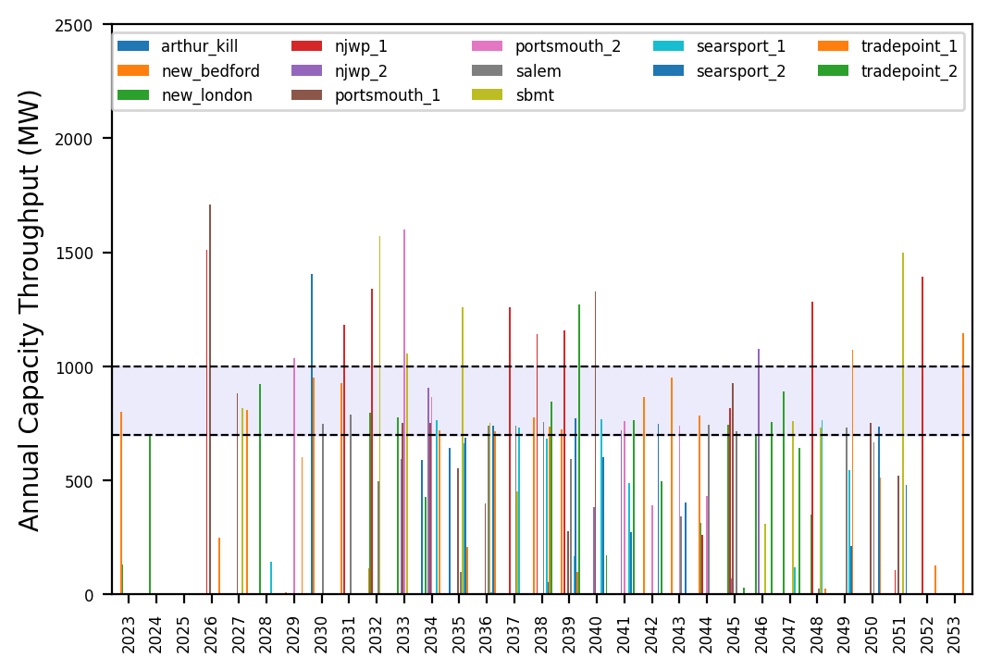
Port Throughput

Slide 19
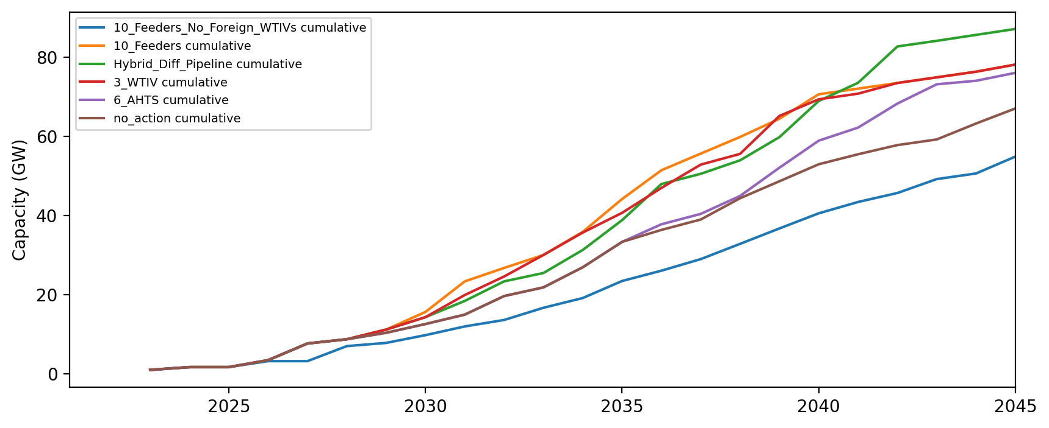
Installed Capacity

Slide 20
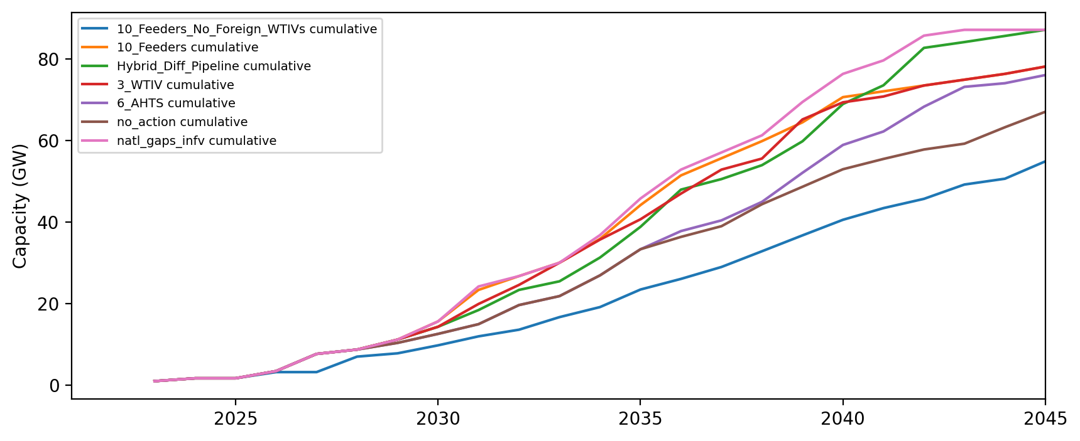
Installed Capacity

Slide 21
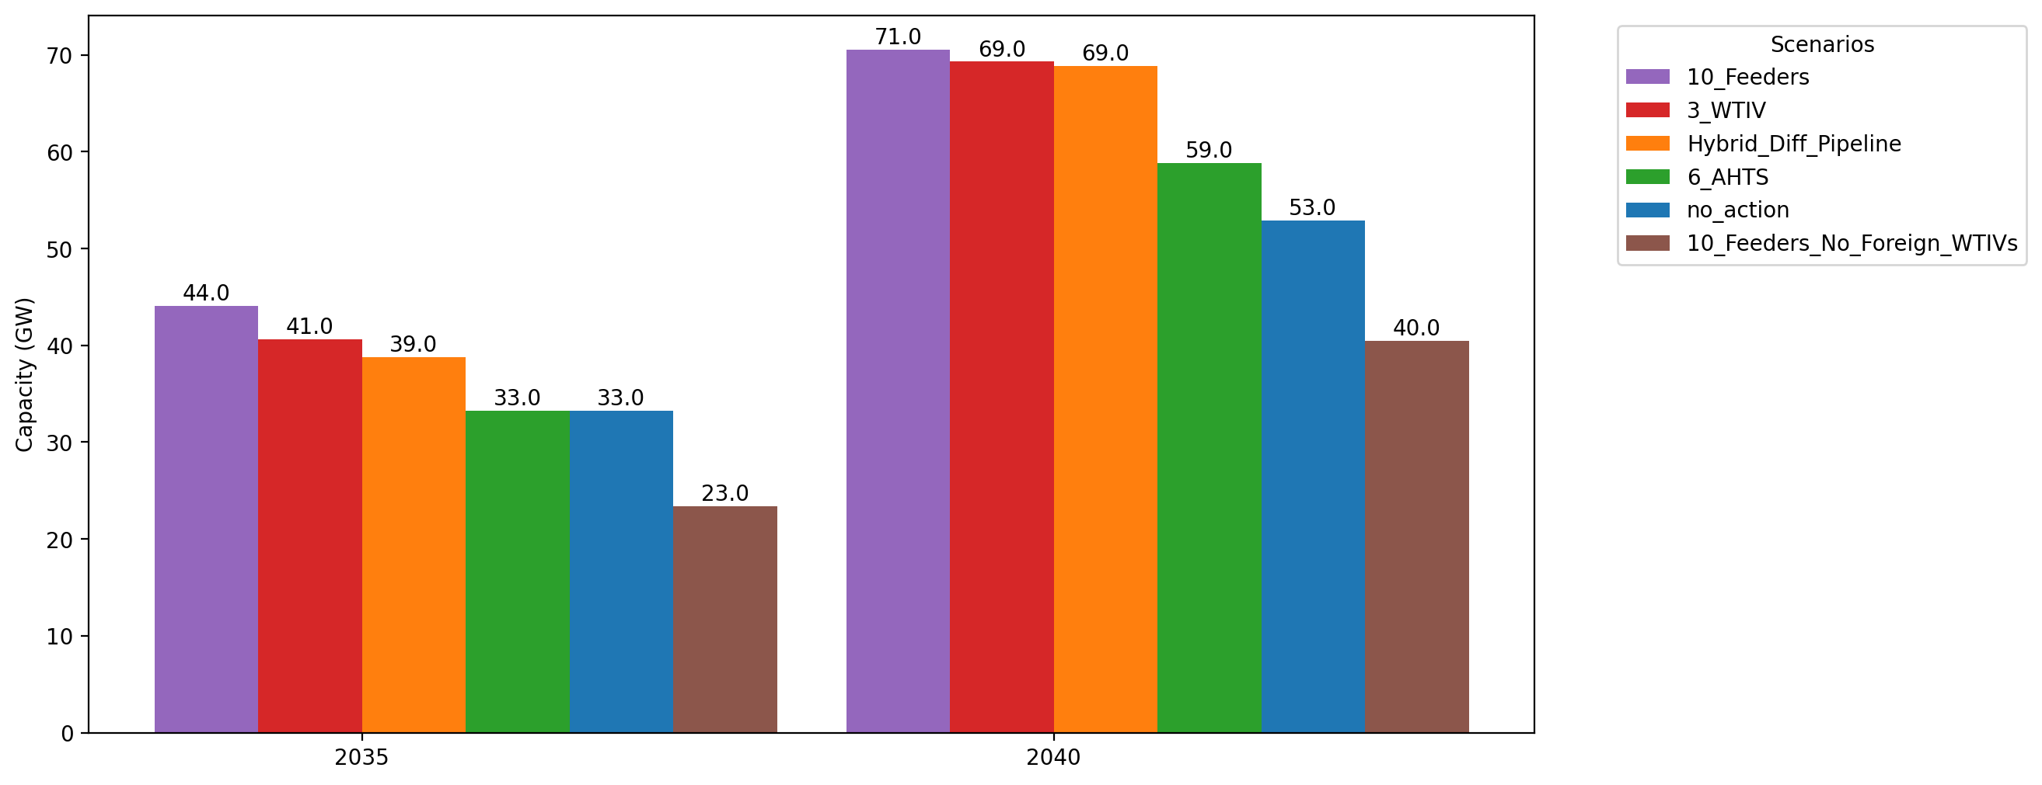
Cumulative Capacity by 2035 and 2040

Slide 22
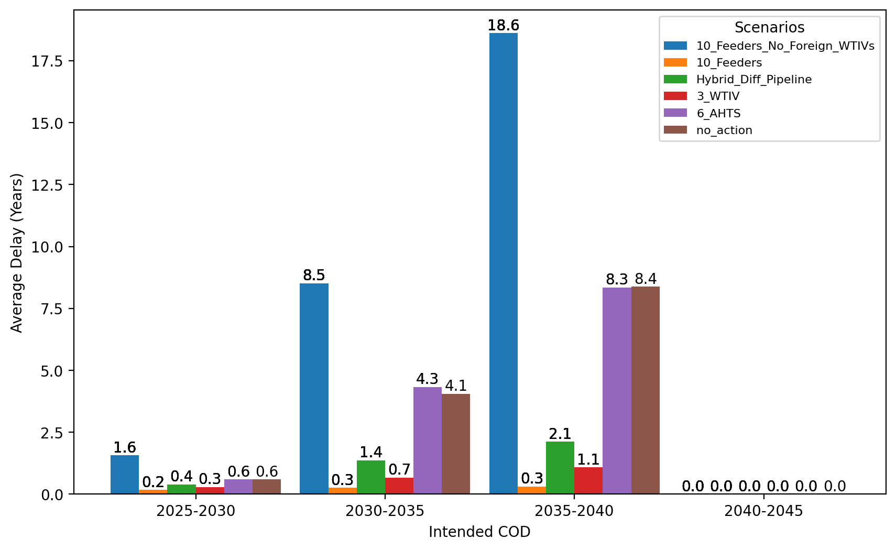
Average Delay Per Project by COD - All Regions

Slide 23
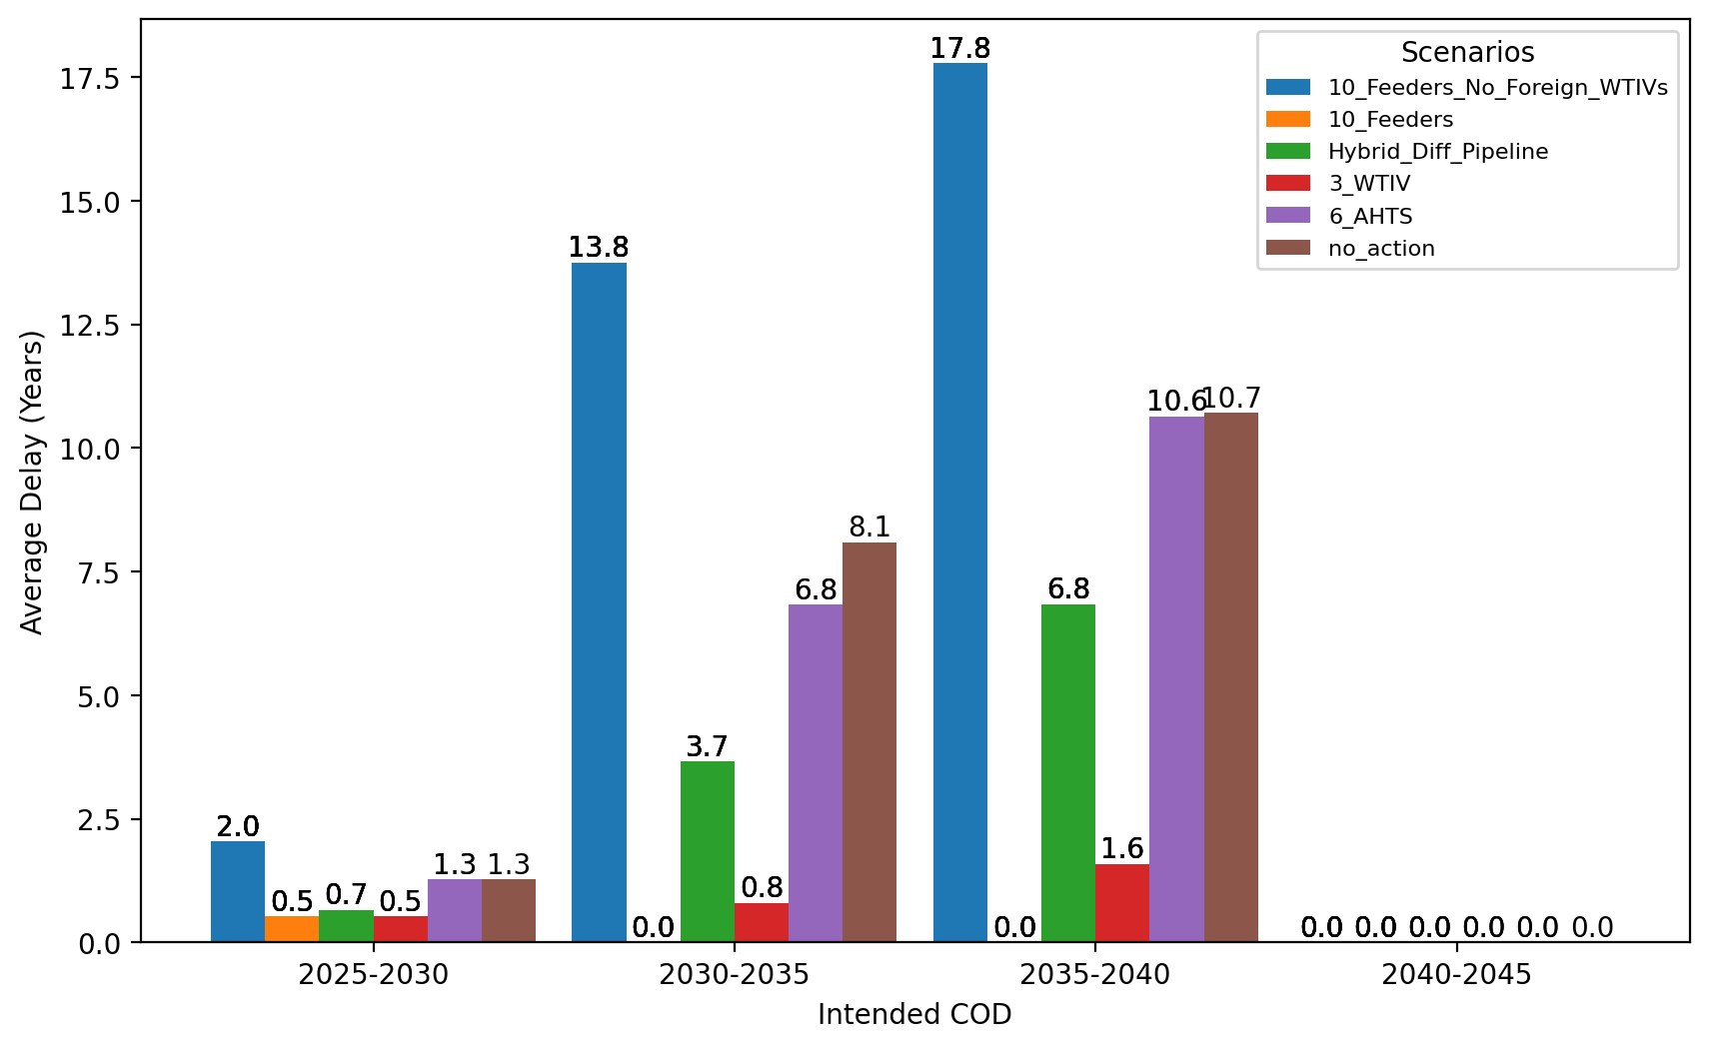
Average Delay Per Project by COD - NE

Slide 24
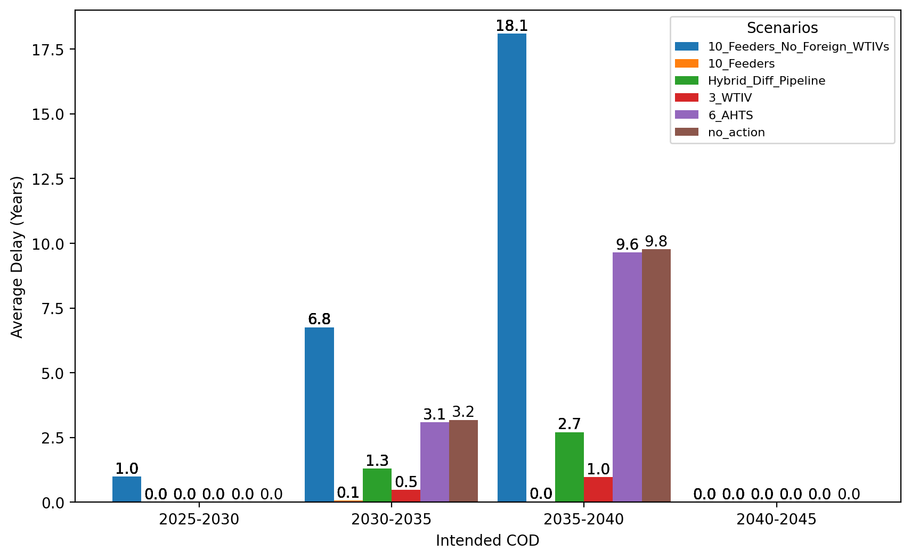
Average Delay Per Project by COD - NYNJ

Slide 25
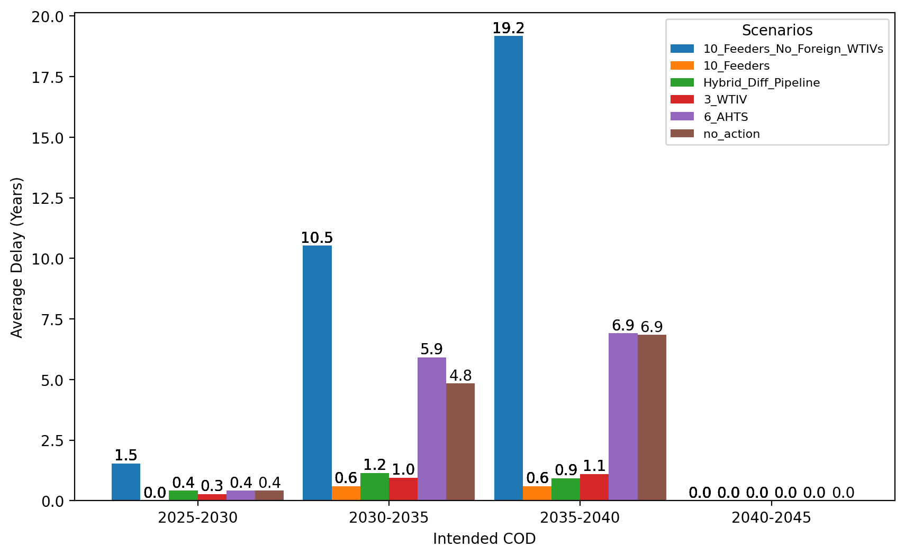
Average Delay Per Project by COD - Mid-Atlantic

Slide 26
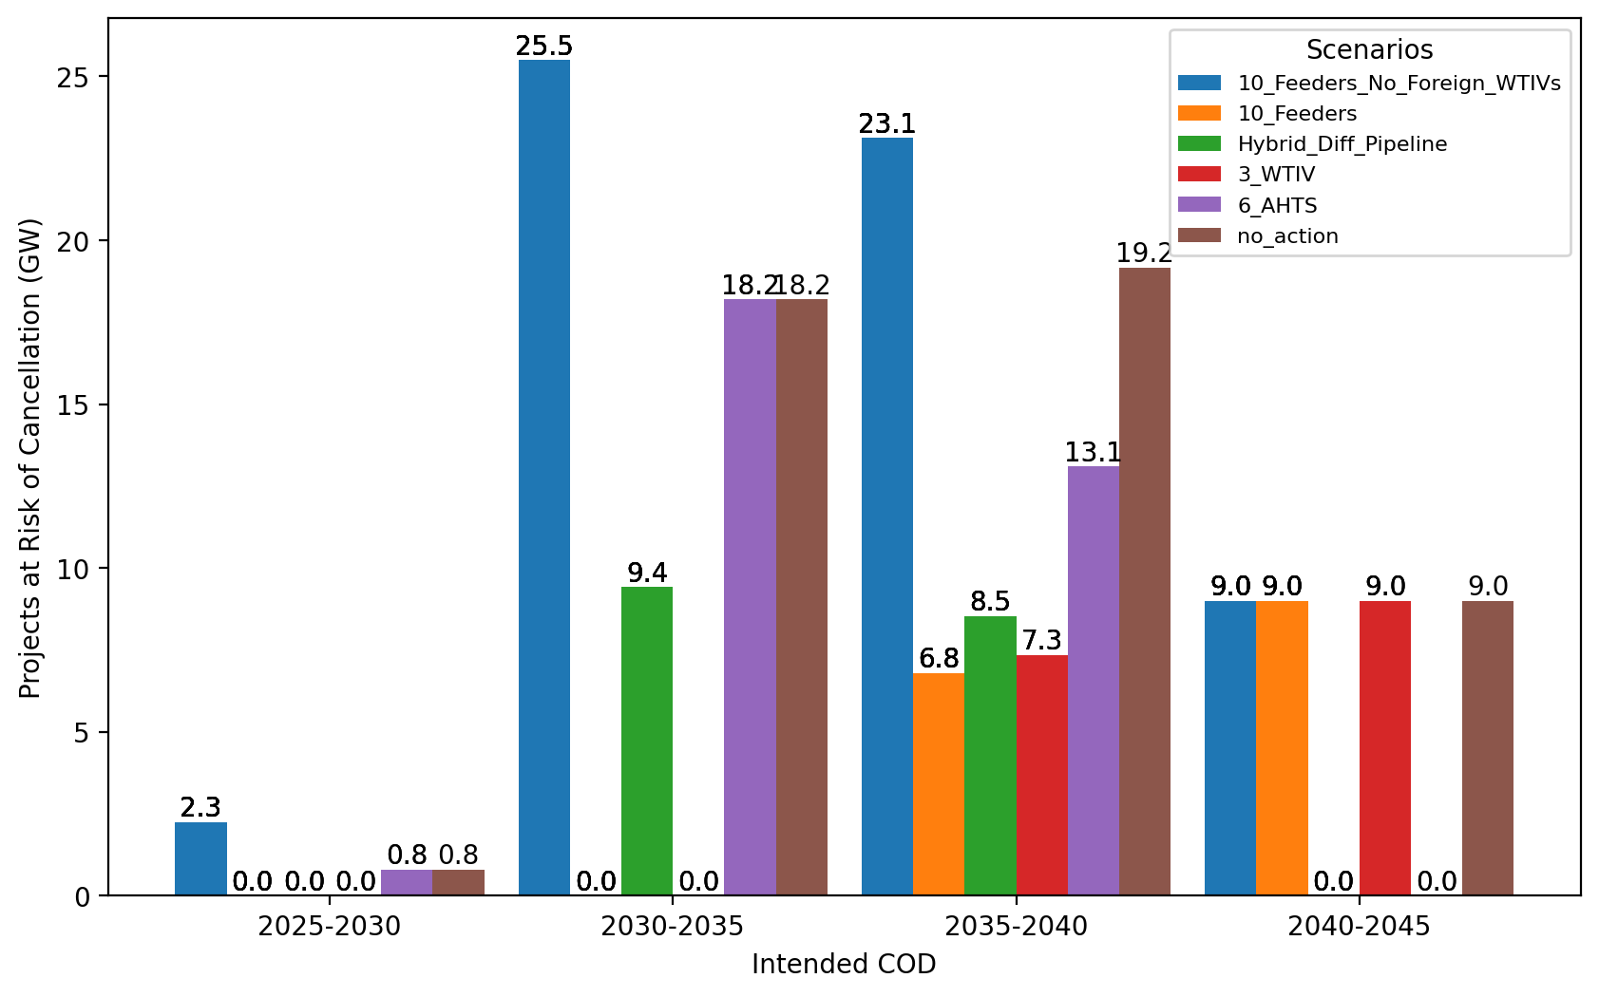
Total Capacity at Risk by COD - All Regions

Slide 27
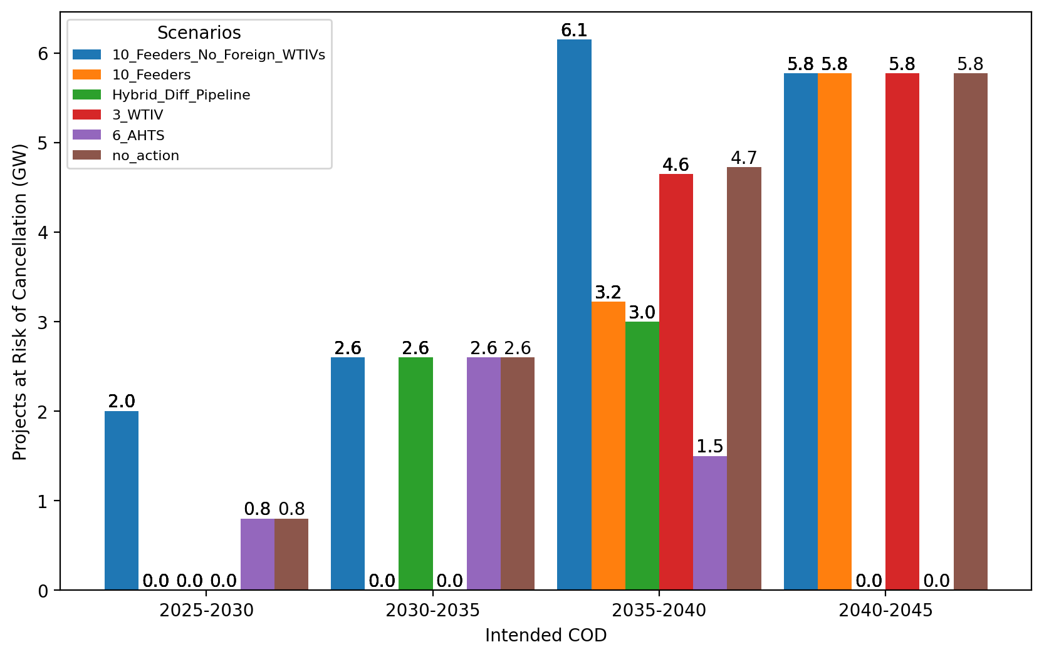
Total Capacity at Risk by COD - NE

Slide 28
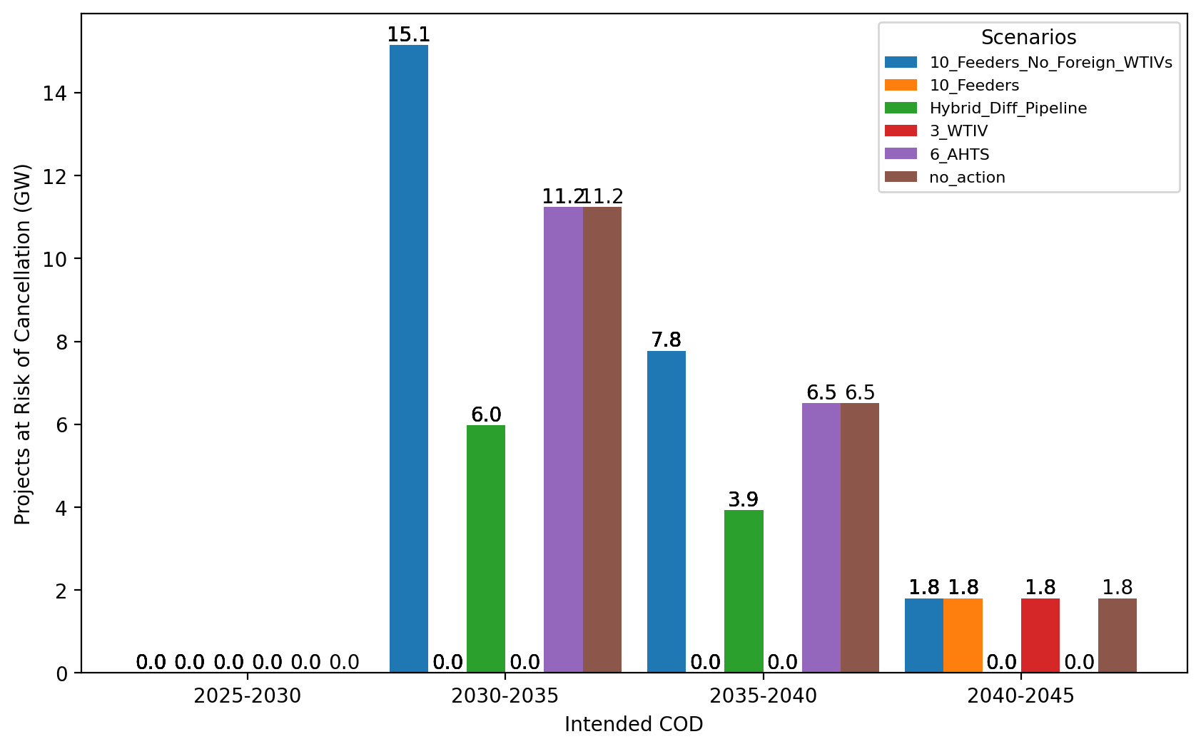
Total Capacity at Risk by COD - NYNJ

Slide 29
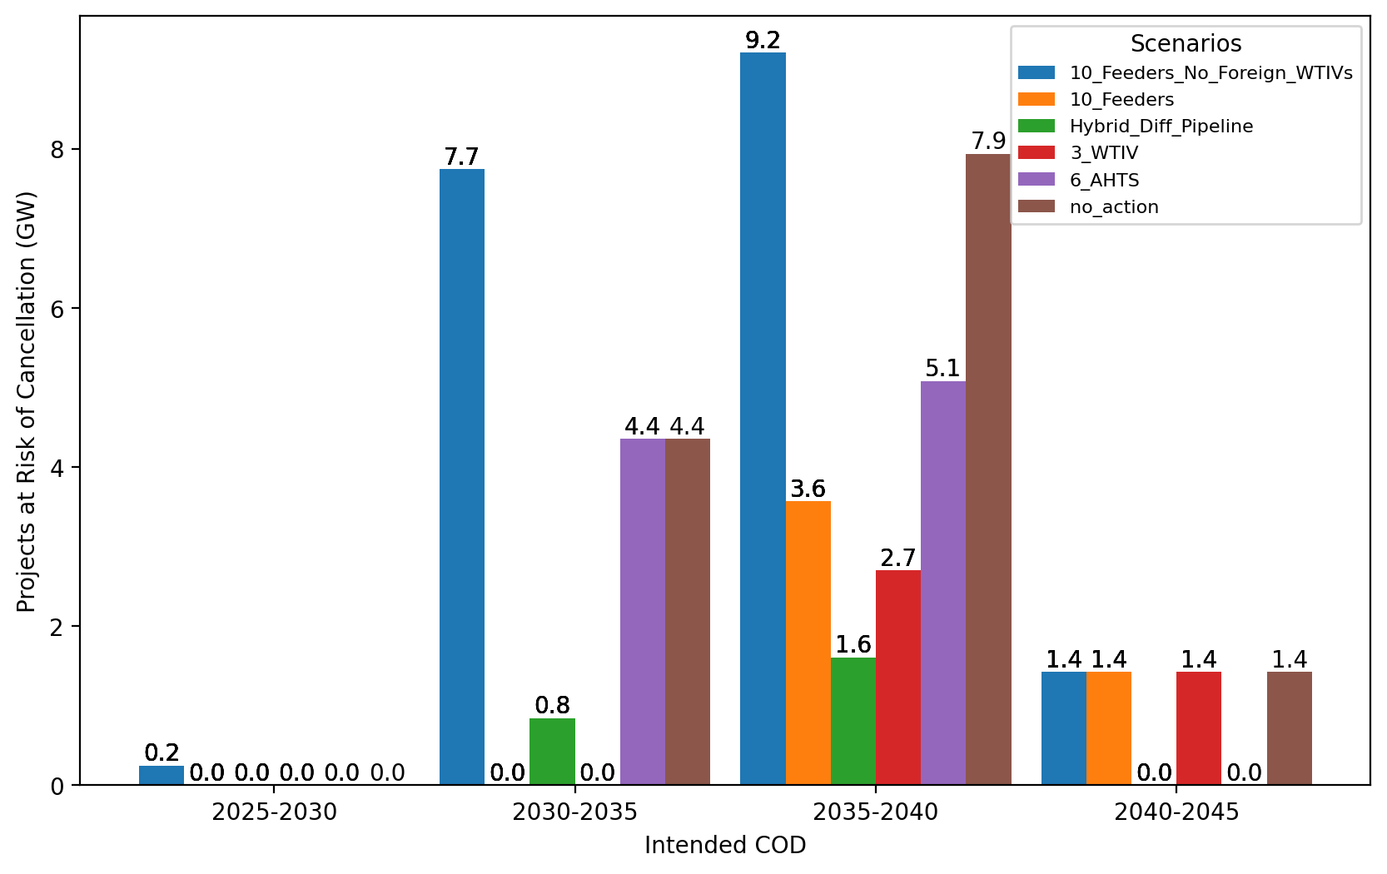
Total Capacity at Risk by COD - Mid-Atlantic

